Slide 1
Information Visualization
final presentation
Dávid Juraj Szücs, Erick Fernando Villa Rodriguez, Esteban Velásquez Rendón

Slide 2
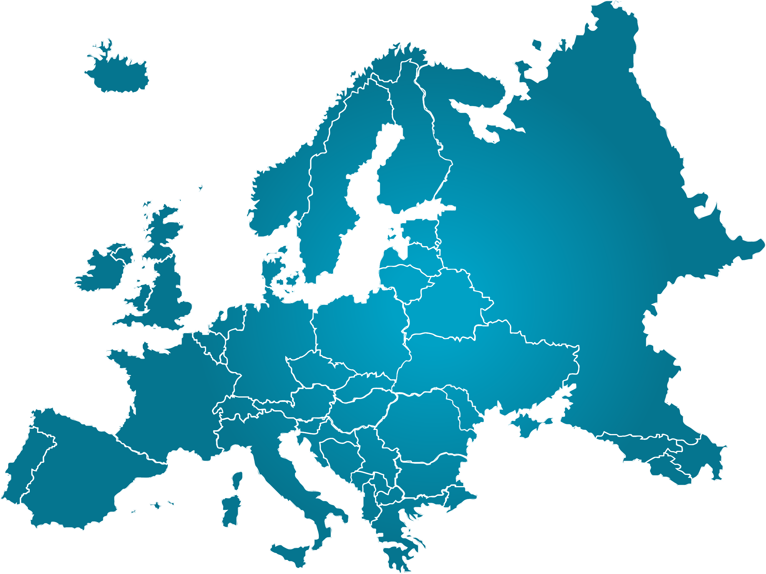




Introduction
Overview
Project Title: | Dependency of EU on Russian energy imports
Target user: | General European public
Target goal: | Informative purposes
Outline of the presentation:
Datasets
Data preprocessing
Visualization framework
Components of the visualization
Widgets, features and interactivity
Feedback and conclusion
Notes:
Target user/task (general goal) (-> User Experience Questionnaire (UEQ))
General European public for informative purposes. -> Politician decides based on public opinion (important to get clear, understandable and readable data) to get the factual base

Slide 3
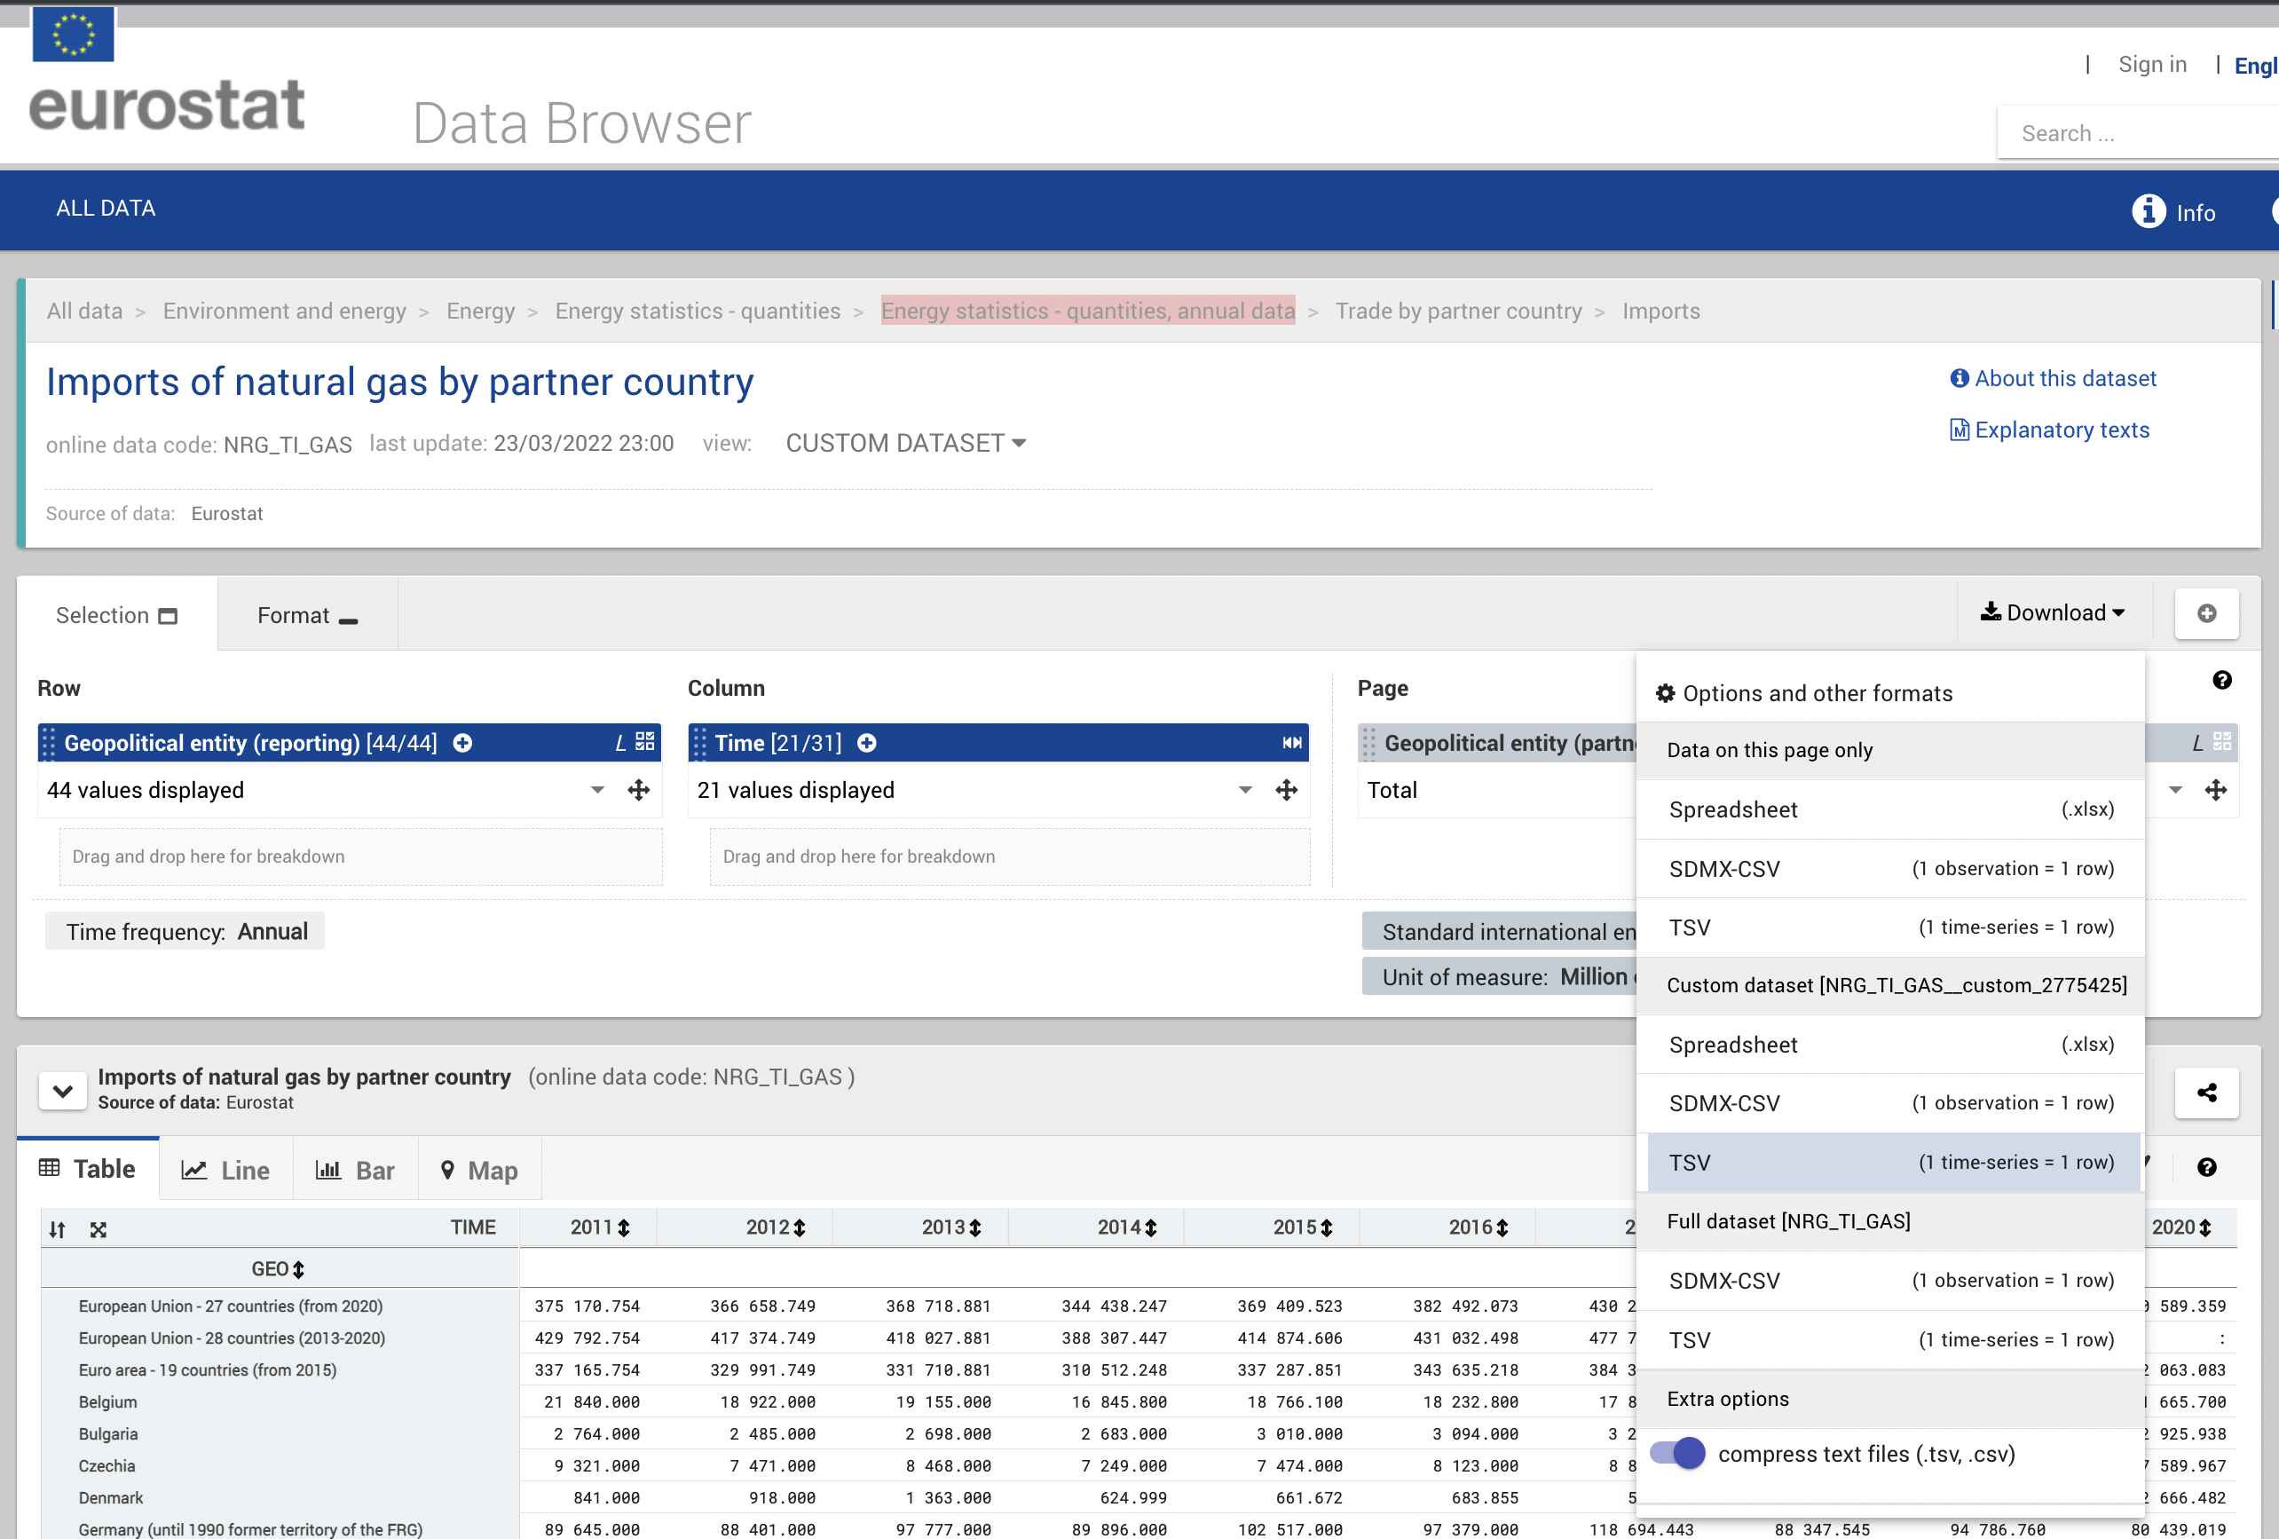
datasets
Sources
Source: Eurostat
Energy Import:
Imports of natural gas by partner country
Imports of solid fossil fuels by partner country
Imports of oil and petroleum products by partner country
Energy Imports Dependency
Shapefile with border lines (geometry) of the European countries.
Notes:
Eurostat website allows to download selected data – not necessary to work with the whole dataset
Using Eurostat -> prefiltered at the download (by geographical entities, time, partner…) -> allowed checking the quality of the data beforehand

Slide 4
datasets
Download in a chosen format
Filtering before pre-processing
Sources
Source: Eurostat
Energy Import:
Imports of natural gas by partner country
Imports of solid fossil fuels by partner country
Imports of oil and petroleum products by partner country
Energy Imports Dependency
Shapefile with border lines (geometry) of the European countries.
Notes:
Eurostat website allows to download selected data – not necessary to work with the whole dataset
Using Eurostat -> prefiltered at the download (by geographical entities, time, partner…) -> allowed checking the quality of the data beforehand

Slide 5
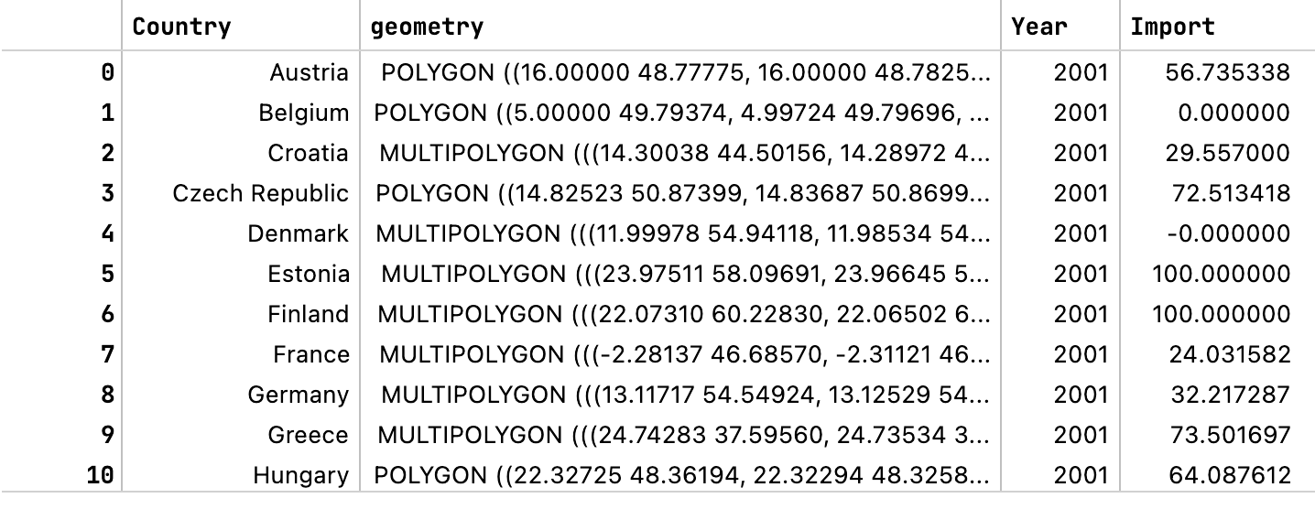
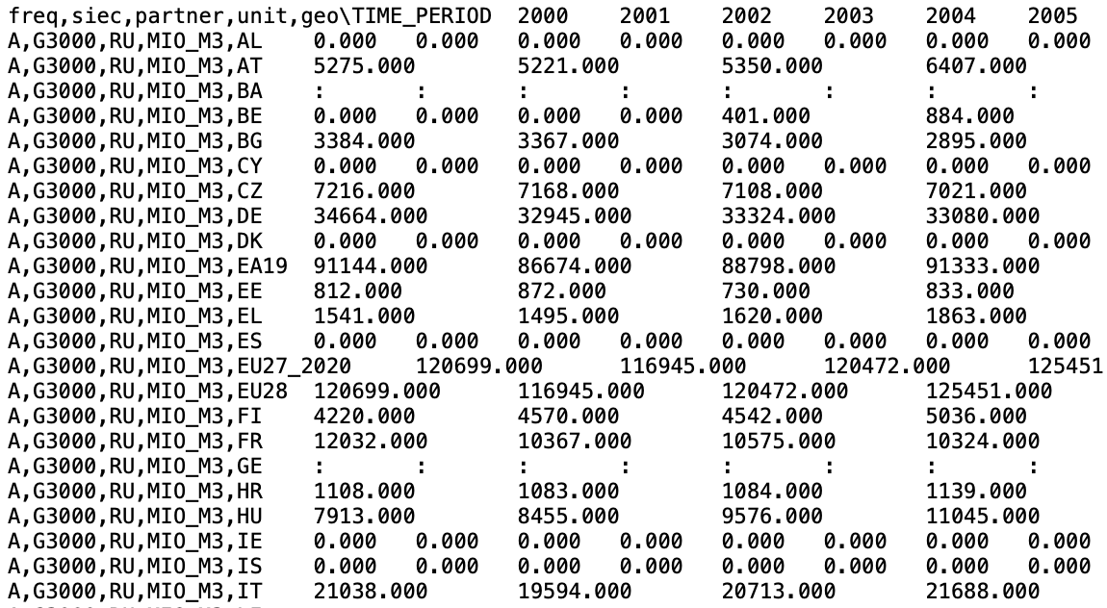
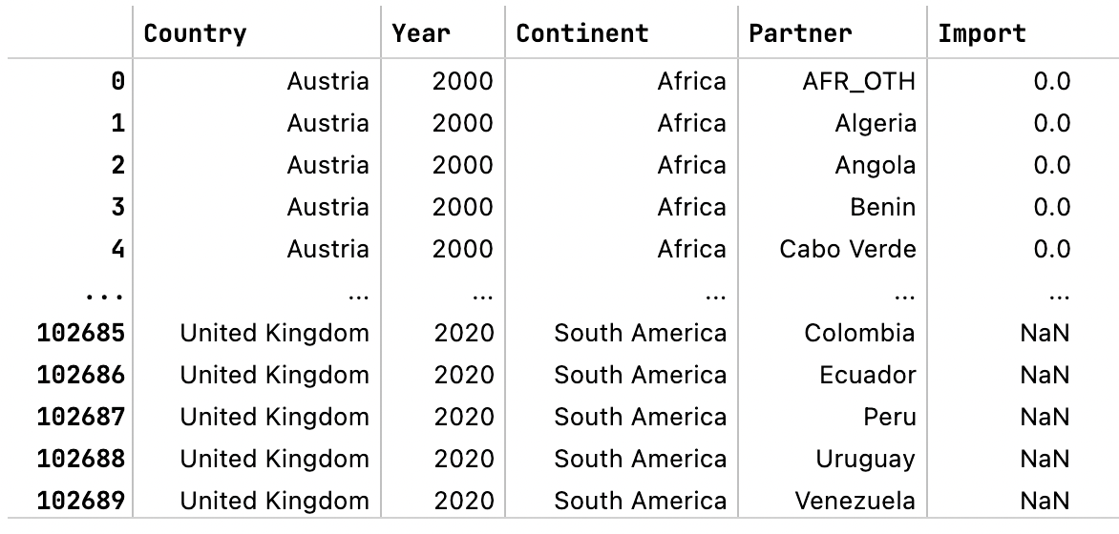
Data preprocessing
Prepared dataframe for a map:
Desired Format
Downloaded .tsv file
Prepared dataframe for a treemap:
Handling dataset with Pandas
Saving preprocessed datasets into pickles
Notes:
We needed to have it this way, so that the callback functions
Callback function that would filter the dataframe by year and return this new dataframe
Or callback funtion that would filter by country
Replace “:” as NaN
Replace country code with complete country name
Assign correct datatype for the columns
Reshape year columns into 1 column

Slide 6
Data preprocessing
division
multiplication
Aggregations
Datasets aggregations done to get the value of Total dependency on energy import from Russia [%]
The example for The Netherlands (2020 -NG):
Example: Natural gas
Imports of natural gas by partner country (from RUSSIA)
Imports of natural gas by partner country (from TOTAL)
Import from RU
18 117 mil m³
Total import
59 800 mil m³
Relative dependency on import from Russia 2000-2020
Energy imports dependency - natural gas
Relative import from RU
30.3 %
Import dependency
45.0 %
Total relative import from RU
13.6 %
Total relative dependency on import from Russia (w.r. to countries’ own production)

Slide 7
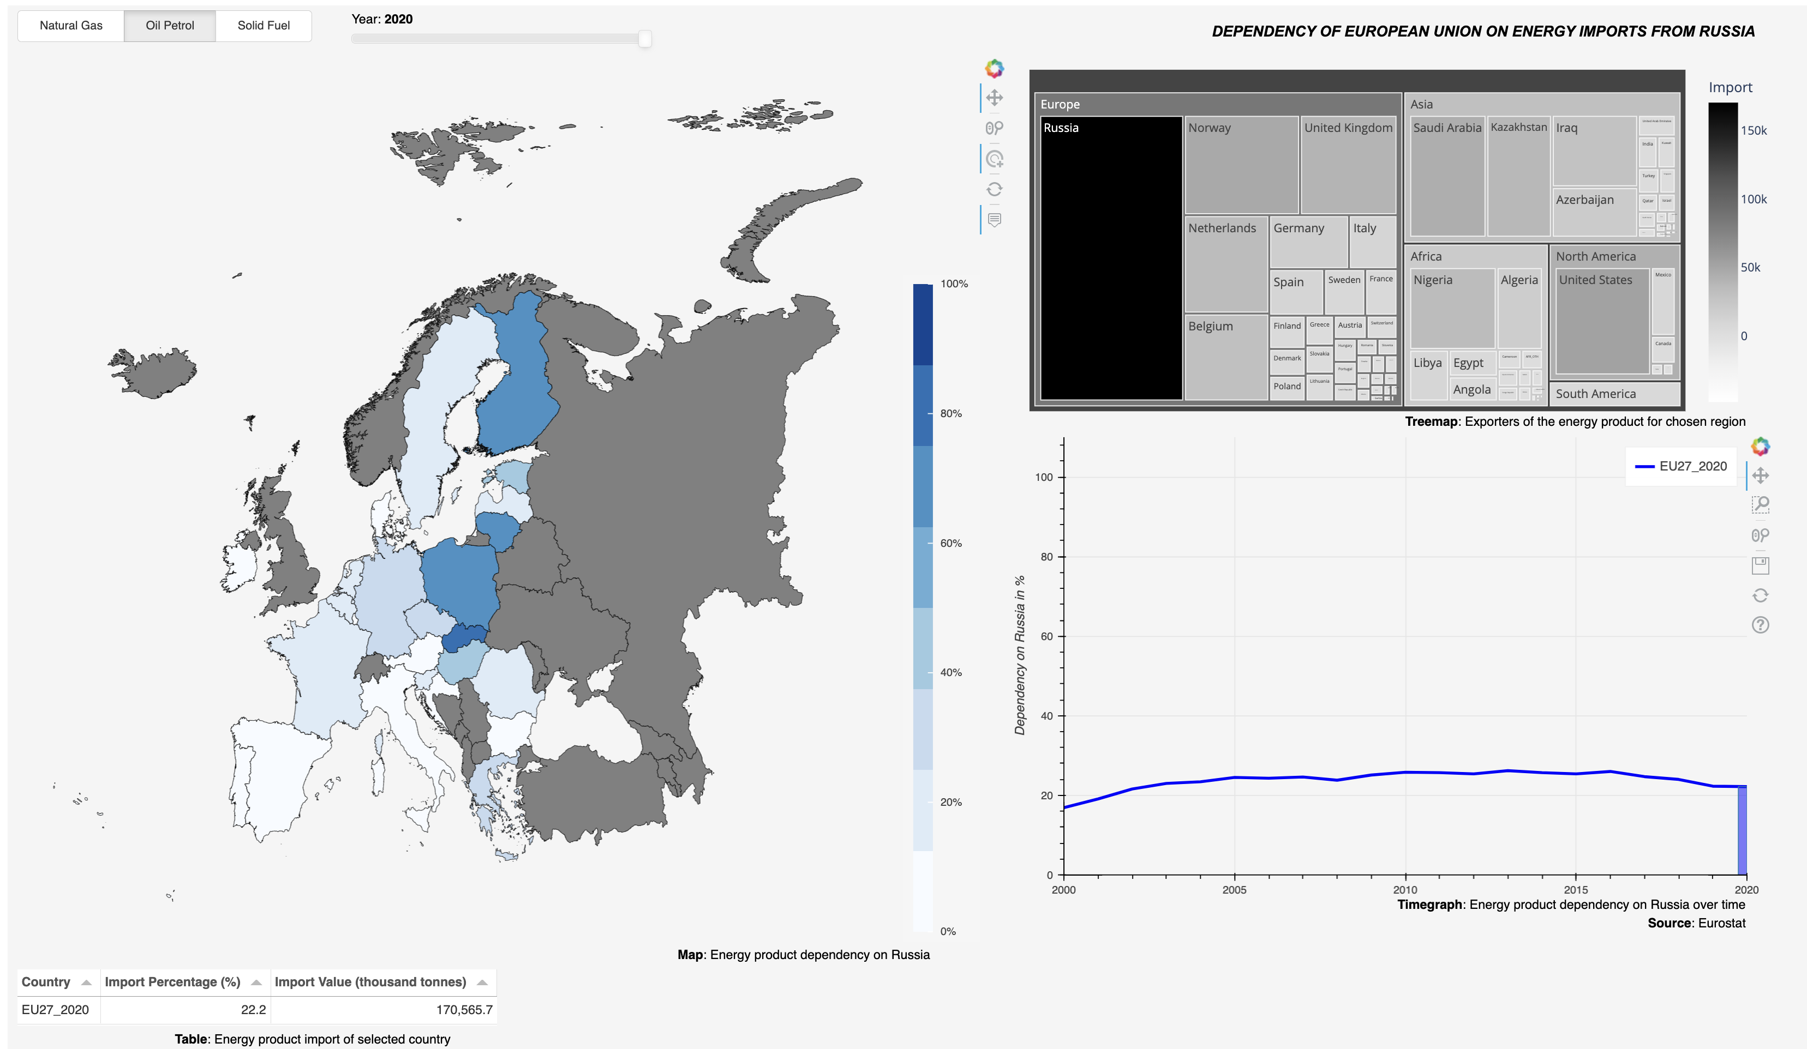
Components of Visualization
FInal IDEA
Frameworks:
Panel
Bokeh
Plotly
Components
Choropleth map
Treemap
Timegraph
Other (table, controls)
Notes:
Widgets from Bokeh:
Function on_change( BOKEH OBJECT ) -> Interactivity when slider or radio button changes (replots the map). It has a callback function
HoverTool
Bokeh dashboard works with ROWS and COLUMNS where the visualizations are placed.
ISSUES AND IMPROVEMENTS:
Data with the slider is slow
Waiting with some delay
Looking into other ways to improve performance
Maybe a turning wheel (loading)
Radio buttons – not yet working
Adding different colours for diff import product
Fitting the columns and rows of the dashboard to the screen of the user
Adding some graphical features for more plausability

Slide 8
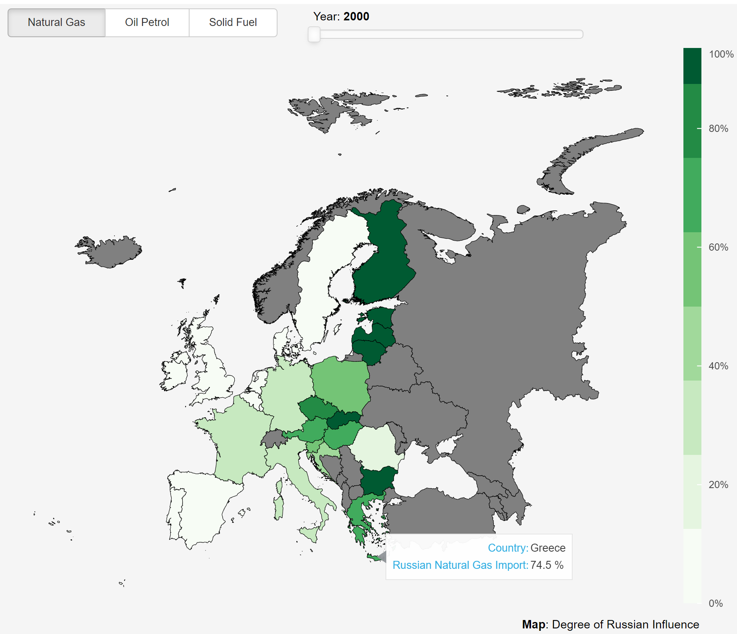
Components of the visualization
Choropleth Map
Datasets included:
Natural gas import from Russia to EU
Oil petrol import from Russia to EU
Solid fuel import from Russia to EU
Main features/widgets:
Radio button group to select dataset
Slider to change time period
Hovertool to display country and value when hovering the mouse over a country
Vertical color bar with color gradient values
Country tapping for specific selection.
Relative
Values
Notes:
Widgets from Bokeh:
Function on_change( BOKEH OBJECT ) -> Interactivity when slider or radio button changes (replots the map). It has a callback function
HoverTool
Bokeh dashboard works with ROWS and COLUMNS where the visualizations are placed.

Slide 9
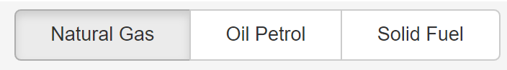
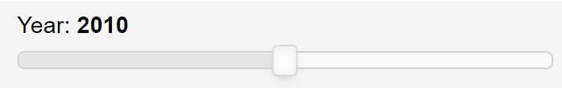
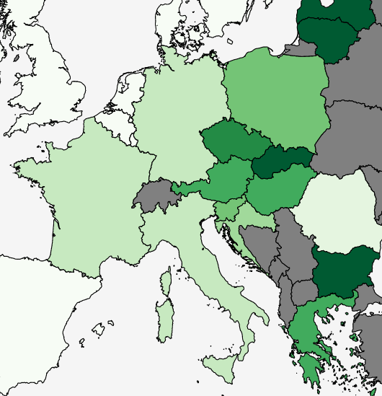
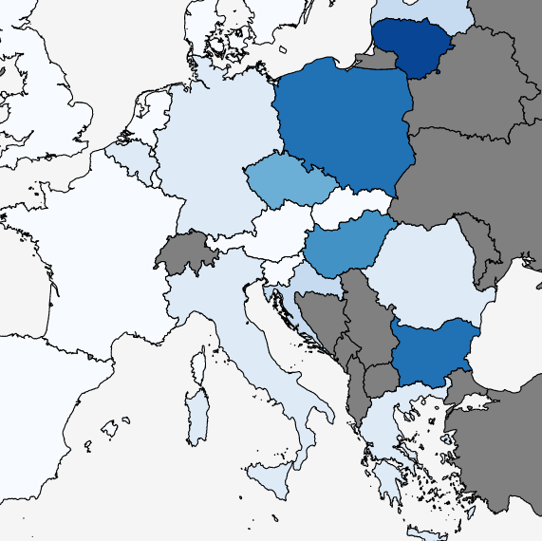
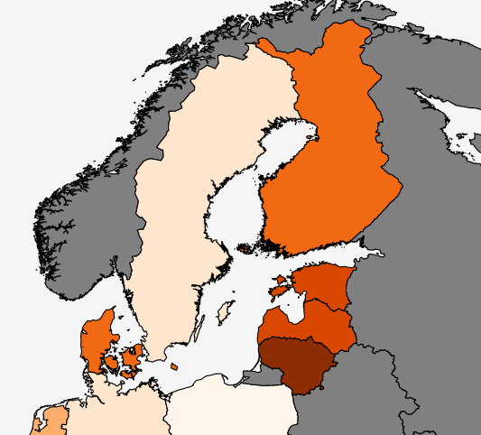
Components of the visualization
INTERACTIVE WIDGETS
Radio button group
Slider
Interactivity through historical data
Default value: 2020
Range: 2000 – 2020
Trigger: mouseUp flag
Interactivity with 3 datasets
3 Color Palletes
Notes:
Widgets from Bokeh:
Function on_change( BOKEH OBJECT ) -> Interactivity when slider or radio button changes (replots the map). It has a callback function
HoverTool
Bokeh dashboard works with ROWS and COLUMNS where the visualizations are placed.

Slide 10
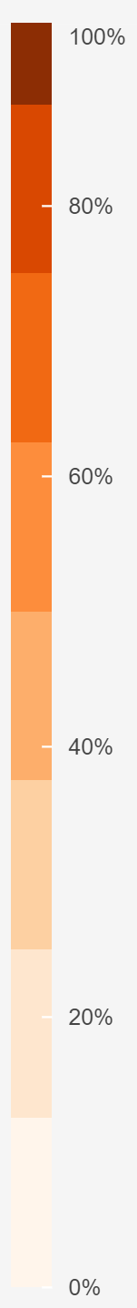
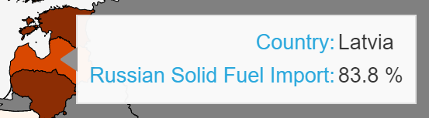
Components of the visualization
Choropleth FEATURES
Hovertool
Vertical Color Bar
Custom hovertool showing the following attributes:
Country
Relative russian energy import from for the selected dataset-year-country
Color Bar matching with the corresponding pallete. Values in percentages (0-100%)
Notes:
Widgets from Bokeh:
Function on_change( BOKEH OBJECT ) -> Interactivity when slider or radio button changes (replots the map). It has a callback function
HoverTool
Bokeh dashboard works with ROWS and COLUMNS where the visualizations are placed.

Slide 11
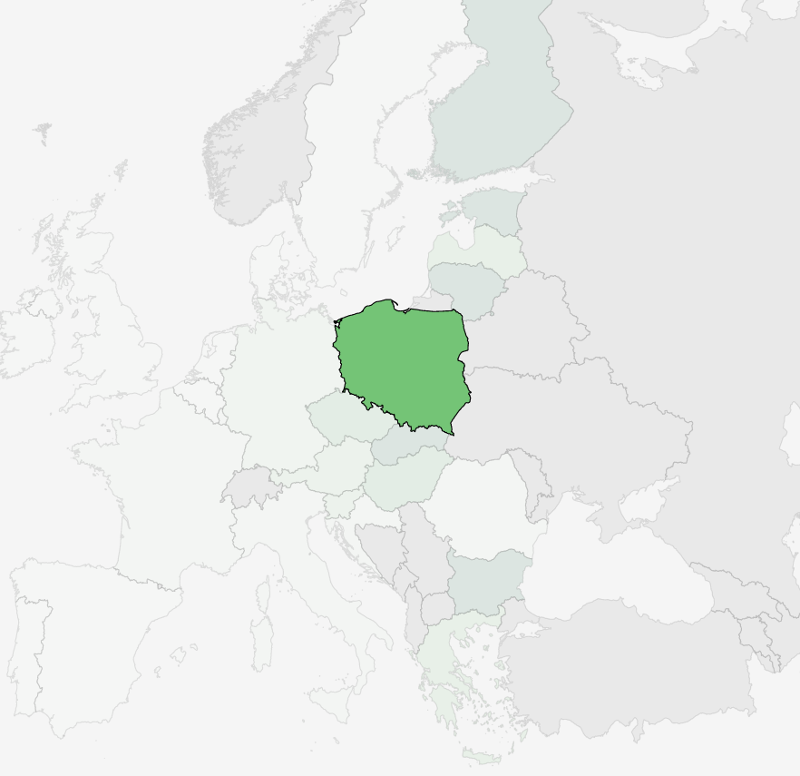

Components of the visualization
Choropleth FEATURES
Country Tapping
Country selection interactivity is provided by clicking on any of the countries presented on the map
By tapping, updates on other dependent graphs are performed, including the treemap, the timegraph and the table.
Notes:
Widgets from Bokeh:
Function on_change( BOKEH OBJECT ) -> Interactivity when slider or radio button changes (replots the map). It has a callback function
HoverTool
Bokeh dashboard works with ROWS and COLUMNS where the visualizations are placed.

Slide 12
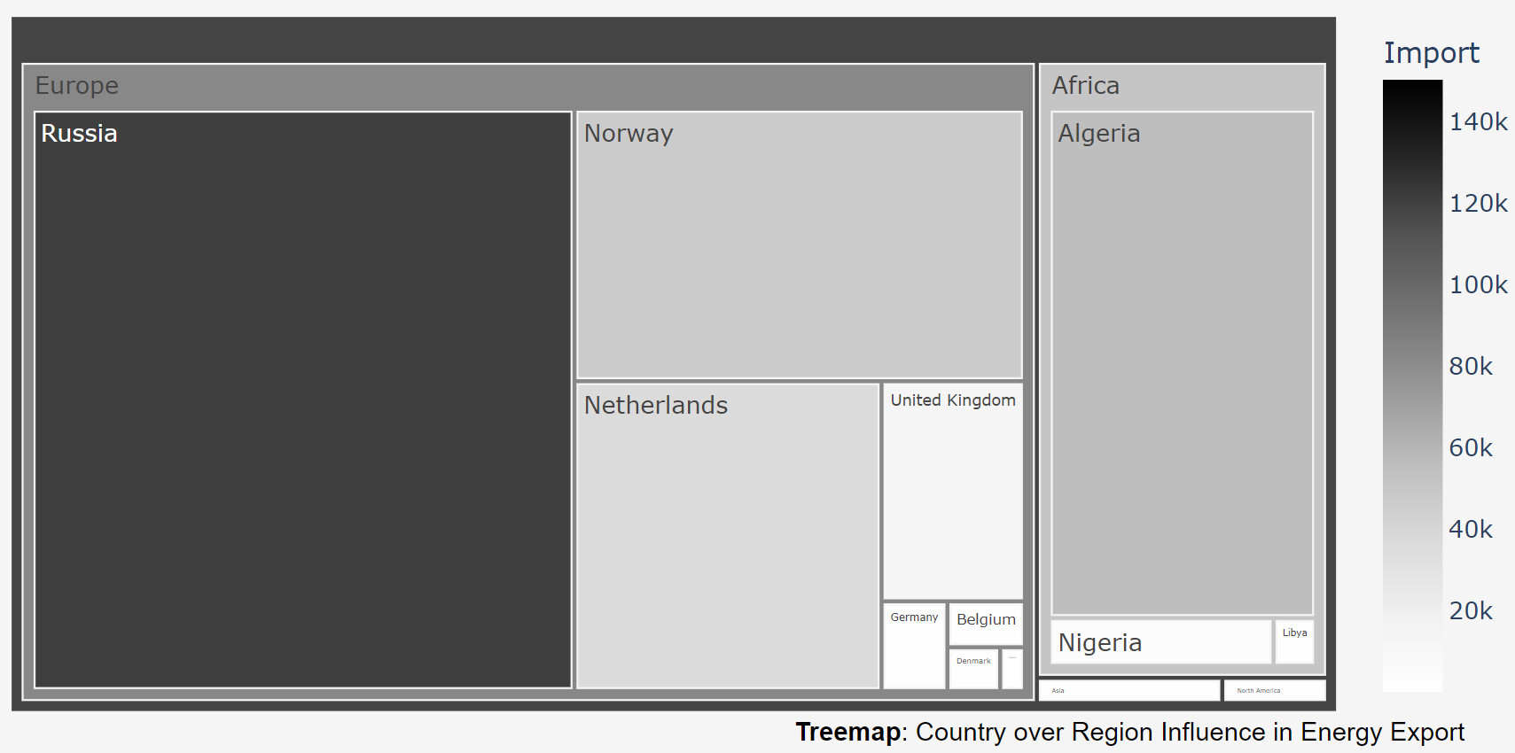
Components of the visualization
treemap
Datasets included:
Natural gas exporters to EU
Oil petrol exporters to EU
Solid fuel exporters to EU
Dependent on:
Radio button group to select dataset
Slider to change time period
Country tapping for specific selection.
Additional Feature:
Color-bar displaying the range of values
Absolute
Values
Notes:
The whole rectangle represents the total import fort the country selected.
Widgets from Bokeh:
Function on_change( BOKEH OBJECT ) -> Interactivity when slider or radio button changes (replots the map). It has a callback function
HoverTool
Bokeh dashboard works with ROWS and COLUMNS where the visualizations are placed.

Slide 13
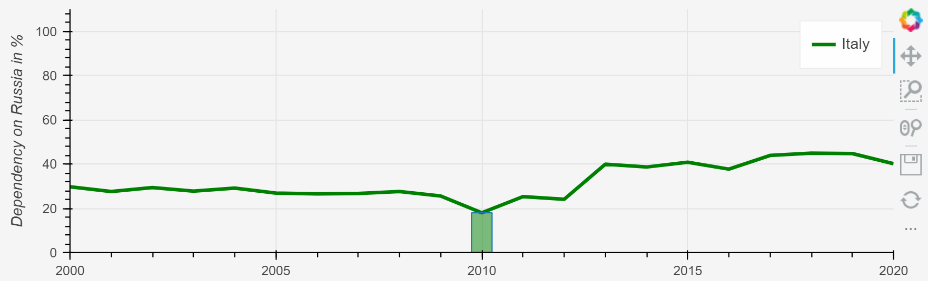
Components of the visualization
Timegraph
Datasets included:
Natural gas import from Russia to EU
Oil petrol import from Russia to EU
Solid fuel import from Russia to EU
Dependent on:
Radio button group to select dataset
Slider to change time period
Country tapping for specific selection.
Additional Feature:
Vertical bar for selected year reference
Relative
Values
Notes:
Widgets from Bokeh:
Function on_change( BOKEH OBJECT ) -> Interactivity when slider or radio button changes (replots the map). It has a callback function
HoverTool
Bokeh dashboard works with ROWS and COLUMNS where the visualizations are placed.

Slide 14
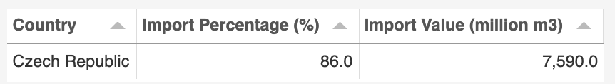
Components of the visualization
Table
Dynamic unit change
Datasets included:
Natural gas export from Russia to EU
Oil petrol export from Russia to EU
Solid fuel export from Russia to EU
Dependent on:
Radio button group to select dataset
Slider to change time period
Country tapping for specific selection.
Relative & Absolute
Values
Notes:
Widgets from Bokeh:
Function on_change( BOKEH OBJECT ) -> Interactivity when slider or radio button changes (replots the map). It has a callback function
HoverTool
Bokeh dashboard works with ROWS and COLUMNS where the visualizations are placed.

Slide 15
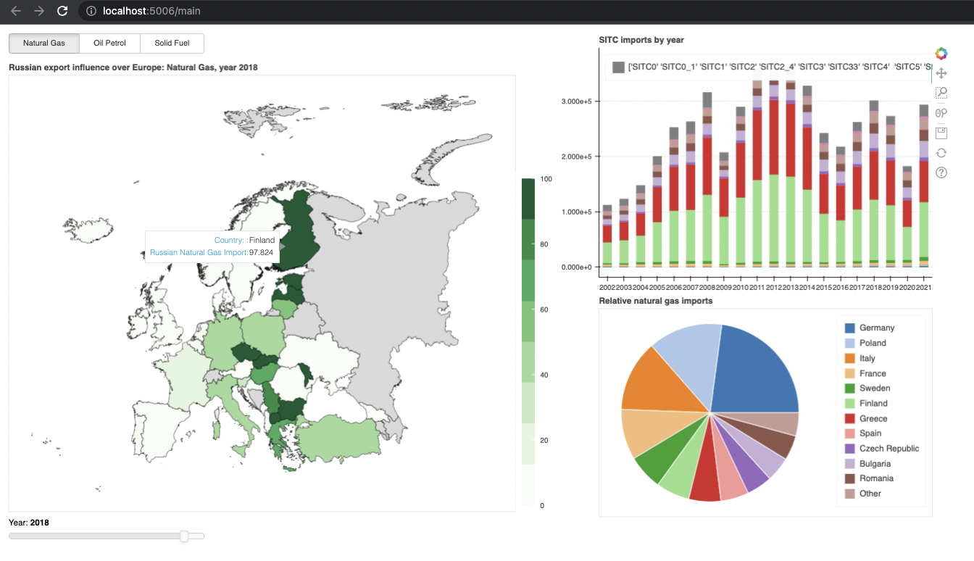
Visualization
Development
27 May 2022
Notes:
Widgets from Bokeh:
Function on_change( BOKEH OBJECT ) -> Interactivity when slider or radio button changes (replots the map). It has a callback function
HoverTool
Bokeh dashboard works with ROWS and COLUMNS where the visualizations are placed.
ISSUES AND IMPROVEMENTS:
Data with the slider is slow
Waiting with some delay
Looking into other ways to improve performance
Maybe a turning wheel (loading)
Radio buttons – not yet working
Adding different colours for diff import product
Fitting the columns and rows of the dashboard to the screen of the user
Adding some graphical features for more plausability

Slide 16
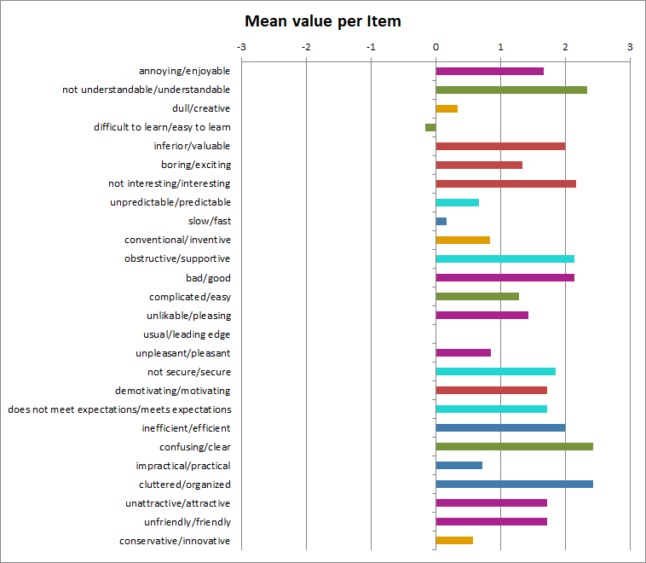
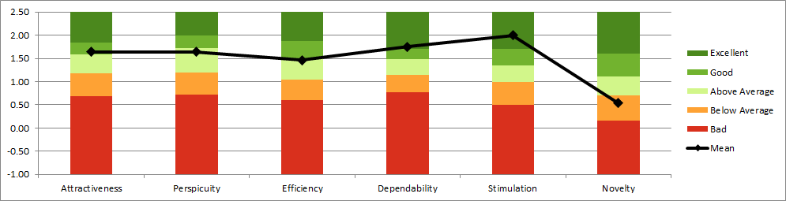
Evaluation
Scale | Mean | Comparisson to benchmark
Attractiveness | 1.64 | Good
Perspicuity | 1.64 | Above Average
Efficiency | 1.46 | Above Average
Dependability | 1.75 | Excellent
Stimulation | 2.00 | Excellent
Novelty | 0.54 | Below Average

Slide 17
Conclusion
& discussion
Straightforward visualization of complex datasets on energy imports for general public
Dealing with geographical information over time
Map, Treemap, Timegraph
Seeing at the same time: the most dependent countries, changes over time and biggest exporters
Questionnaire: Clear, organized, understandable, supportive
Further possible improvements from the questionnaire (difficult to learn, not that fast, dull)
Notes:
What?
Problem?
Achieved goal!
Negative points from the questionaire
Difficult to learn -> Even though the vis is for general public, it was meant to be a part bigger context (digital content, website, hyperlink)
Not that fast -> using more advanced database approaches would benefit the visualization -> to improve (clicking is fast, but year slider and data selector is slower)
No novelty -> The libraries used do not offer that much of the personalization

Slide 18
Thank you for youR feedback

